Slide 1
In Vitro (In Vivo*) 3D-printed biopolymeric bone scaffolds regeneration
Natalia Milaniak
Techniki Obrazowania i Biometria
Fizyka Medyczna, AGH 2016
*depending on In-Vitro results

Slide 2
Content
Bone
Macro and Micro Structure
3D Printer
Materials
Biological and chemical properties
Osteoblast Isolation, Culture and Development
Calvarial Osteoblast Attachment, Proliferation and Function
Bone Formation by Implantation of Osteoblast-Seeded 3D Cellular scaffolds into Rabbit femur

Slide 3
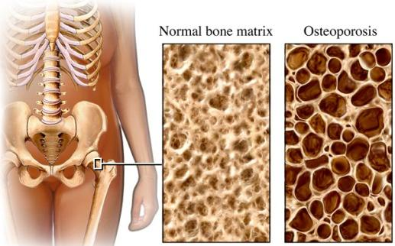
Źródło [4]

Slide 4
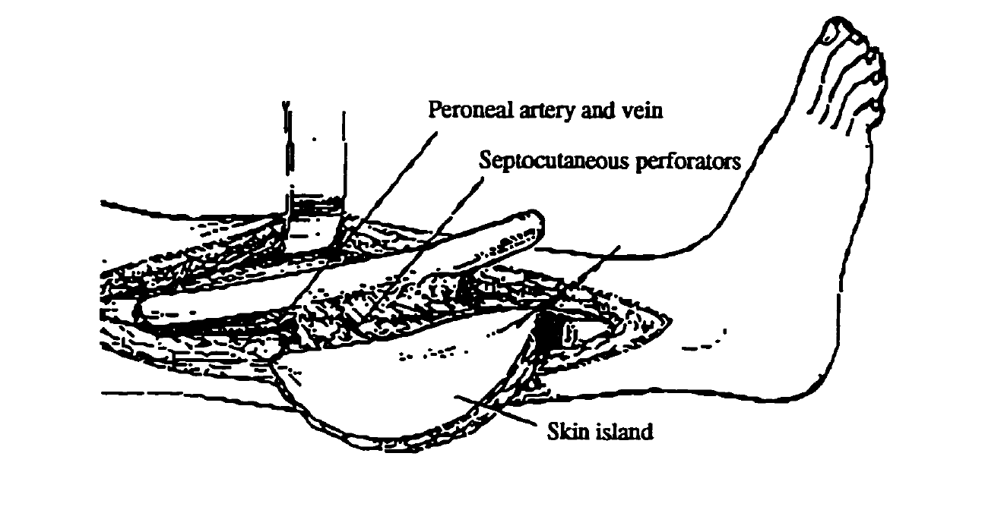
Źródło [15]

Slide 5
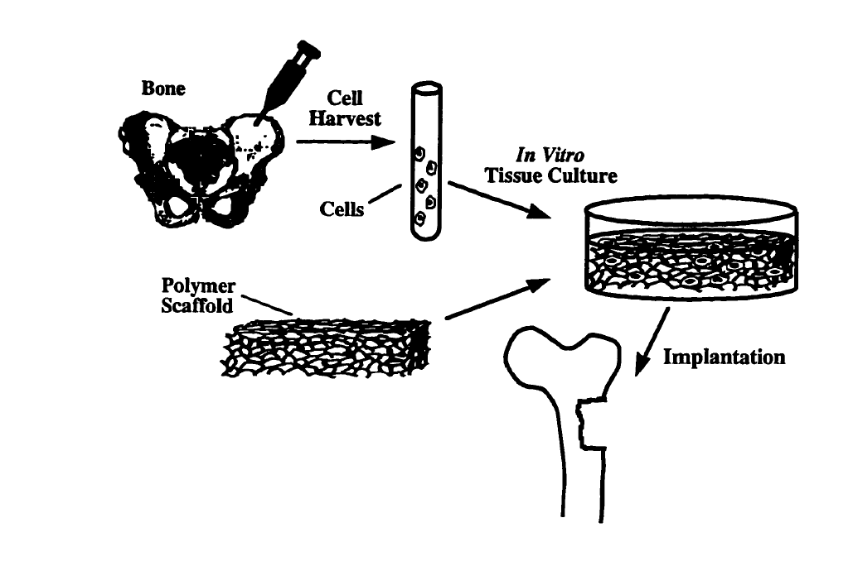
Źródło [15]

Slide 6
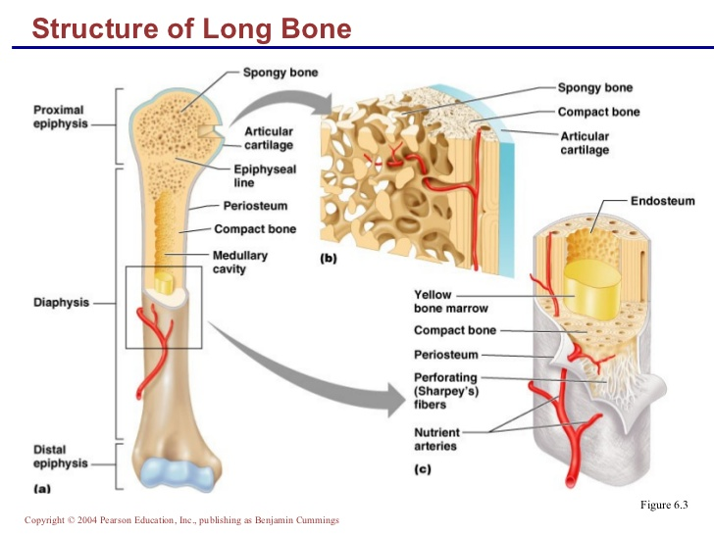
Źródło [4]

Slide 7
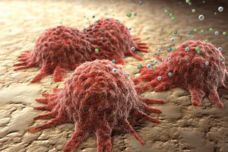
Źródło [2]

Slide 8
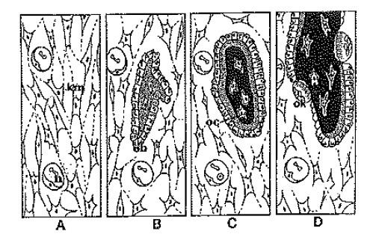
Źródło [1]

Slide 9
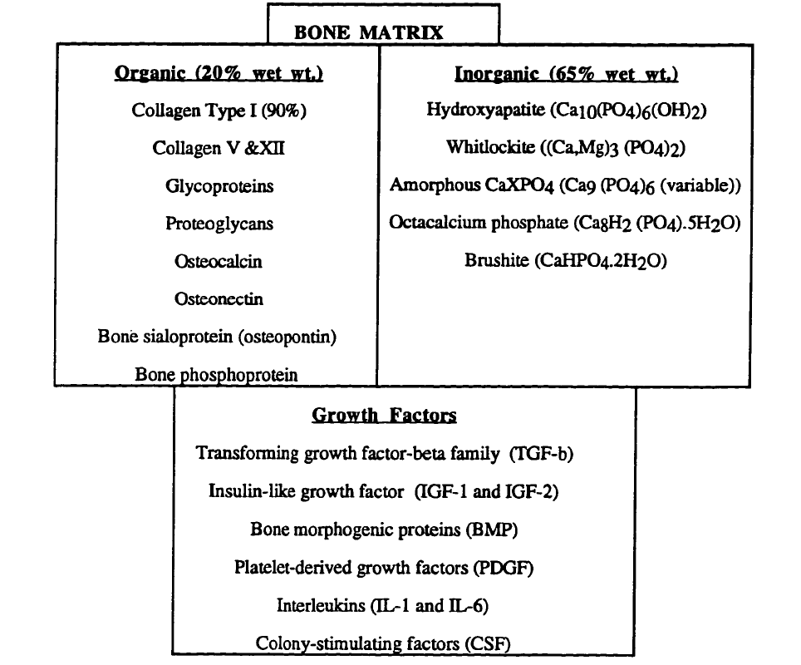
Źródło [16]

Slide 10
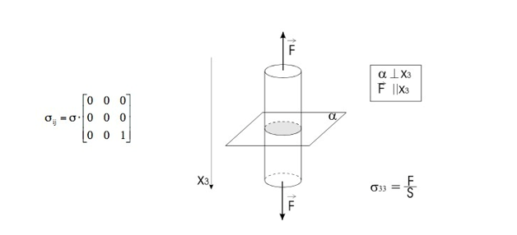
Źródło [15]

Slide 11
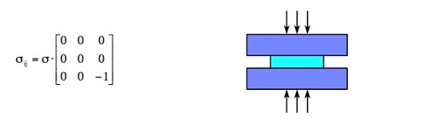
Źródło [15]

Slide 12

Źródło [15]

Slide 13
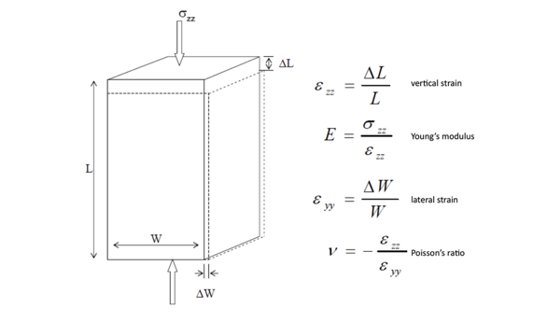
Źródło [15]

Slide 14
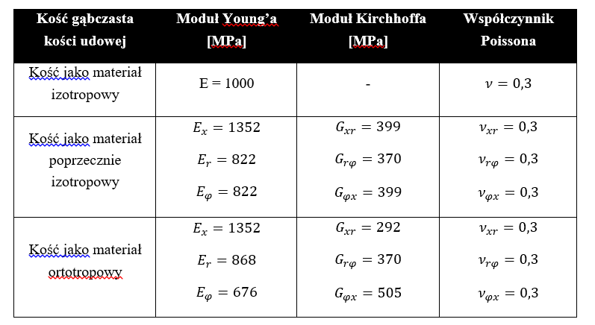
Źródło [10]

Slide 15
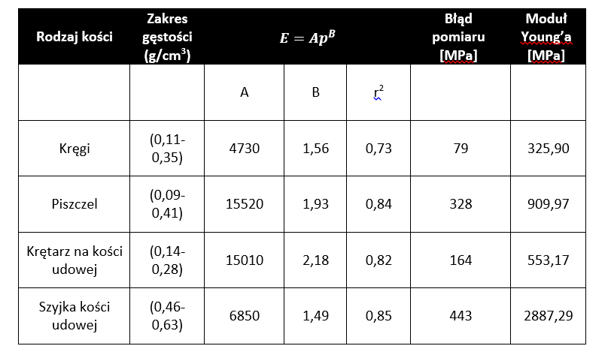
Źródło [10]

Slide 16
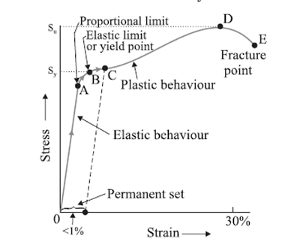
Źródło [14]

Slide 17
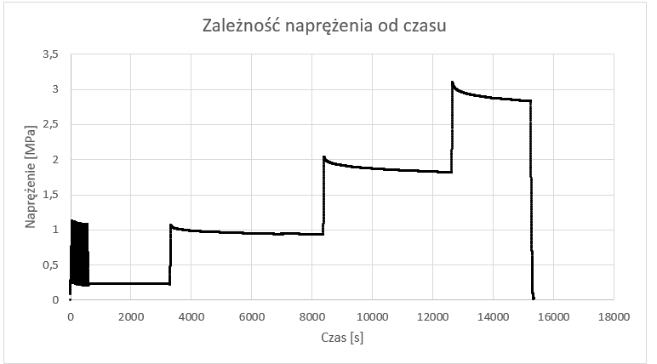
Źródło własne

Slide 18
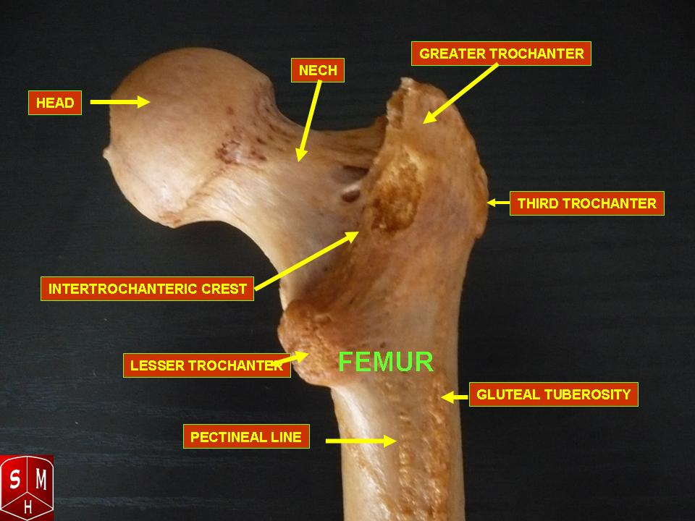
Źródło [12]

Slide 19
Źródło własne

Slide 20
Źródło własne

Slide 21
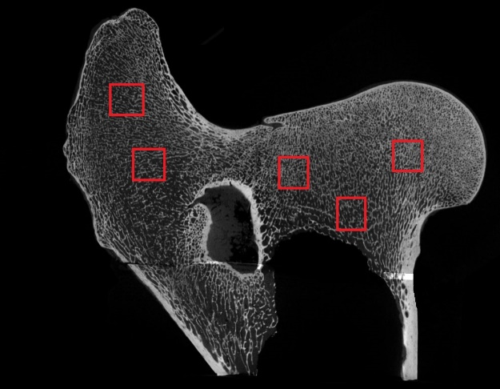
Źródło własne

Slide 22
Źródło własne

Slide 23
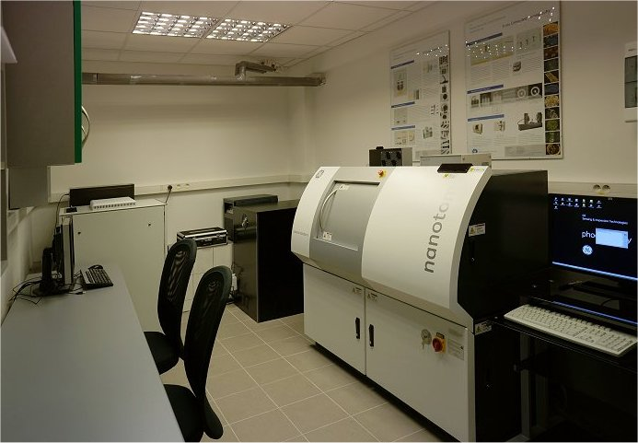
Źródło własne

Slide 24
Źródło własne

Slide 25
Źródło własne

Slide 26
Źródło własne

Slide 27
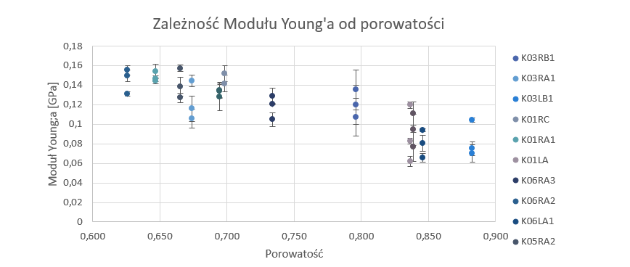
Źródło własne

Slide 28
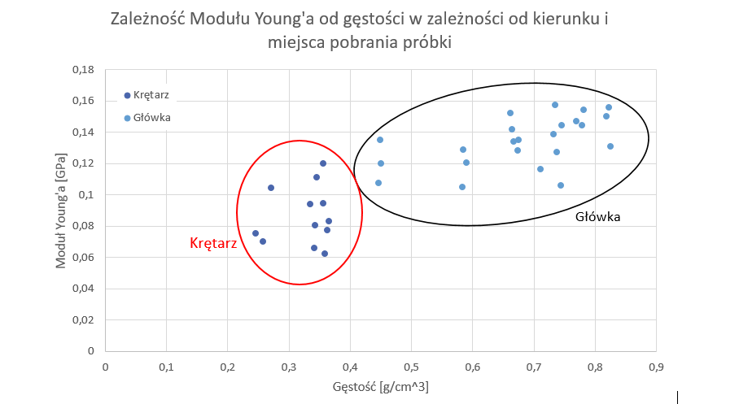
Źródło własne

Slide 29
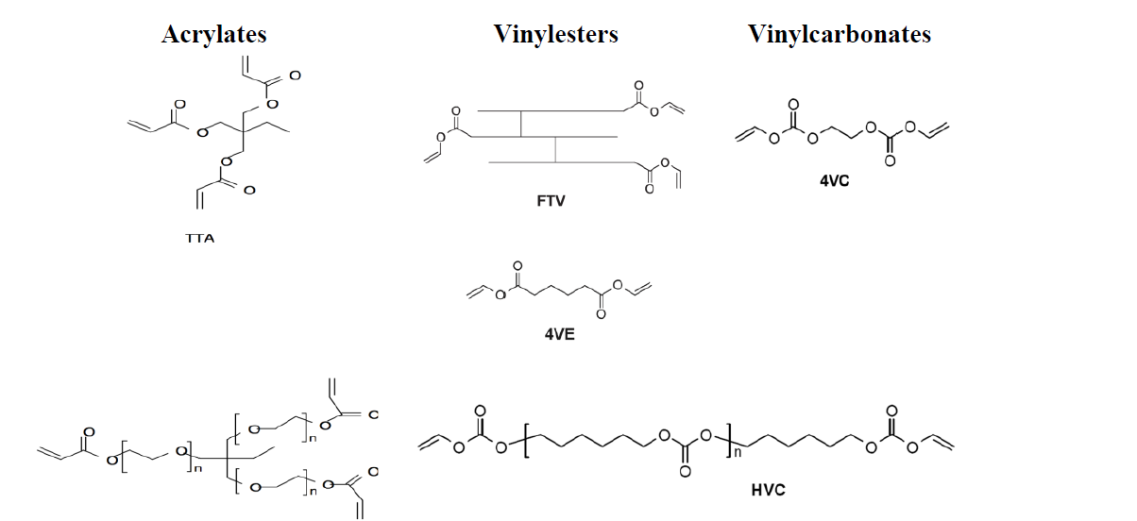
Źródło [16]

Slide 30
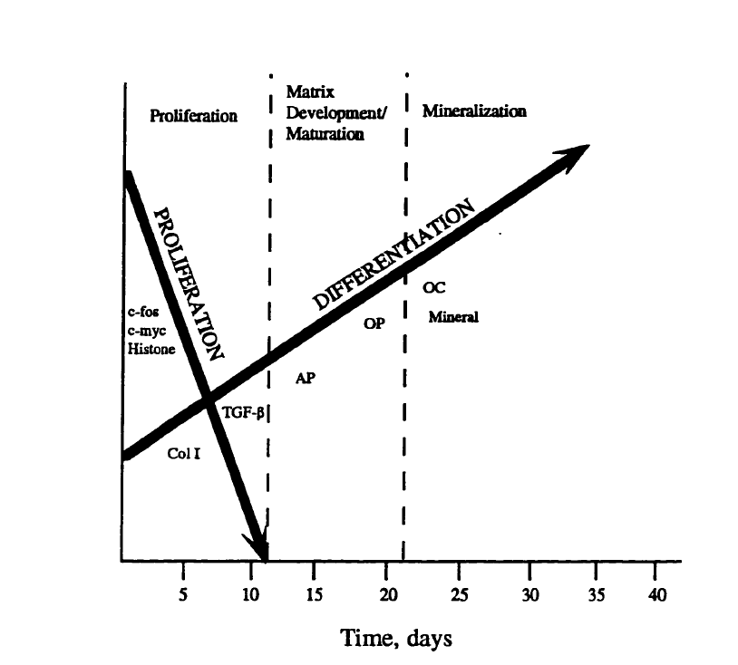

Slide 31
Osteoblast Isolation and Culture
Osteoblasts are isolated from neonatal rat calvaria by enzymatic digestive procces. Briefly, calvaria of rats were stripped of periosteum, minced and stirred in a collagenese/trypsin solution of 5mL of a 0,33% collagenese solution in Mg++ and Ca++ free Dulbecco’s Phosphate Buffered Saline (PBS) containing 2,4% bovine serum albumin (Sigma) and 1mL PET – a trypsin solution containing 0,0625% trypsin in 1,125% NaCl at 37C for three 20 min digestion periods.

Slide 32
Attachement of cells
A numer of osteoblast (approximately 50000 cells/cm2) are plated on the top of the prepared scaffold and on real cow bone as a referance. The cultures are placed in incubators for 0.5, 1, 2, 4, 6 and 8 hours and upon removal are washed with PBS and trypsinized.

Slide 33
Proliferation Studies
Osteoblasts are plated on the scaffolds and left in the incubator for 8 hours before an additional 1mL of complete media is added to each scaffold and cultured. Cell proliferation are determined by cel counts after 1,4, 7, 14 and 30 days in culture.

Slide 34
Histology
The cultures are rinsed with PBS and then fixed in 10% neutral buffered formalin. After being rinsed with water and air dried the samples are viewed under a microscope.

Slide 35
Scaffolds
After rinsing the scaffolds all the properties are measured once again.

Slide 36
Statistical Analysis
ANOVA
Sheffe’s Method

Slide 37
Bibliography
Osteoblast, Portal o zdrowiu – www.trialx.com. [Online] [Zacytowano 30 Czerwiec 2011.] http://trialx.com/curetalk/wp-content/blogs.dir/7/files/2011/05/diseases/Osteoblast-3.jpg
Osteoklast, Portal o zdrowiu – homeopathy.at. [Online] [Zacytowano 16 Grudzień 2011.] http://www.homeopathy.at/wp-content/uploads/Osteoklast-2-300x224.jpg
Budowa kości zbitej, Wydawnictwo książkowe - http://www.pearsoned.co.uk. [Online] [Zacytowano 2004] http://mailgrupowy.pl/files/html/693175,index_html_44e6d8c4.jpg
Tadeusz Cichocki, Kompendium histologii, 2002
Budowa nasady kości udowej, Wikipedia - http://pl.wikipedia.org/wiki/Krętarz_mniejszy [Online] [Zacytowano 2014] http://upload.wikimedia.org/wikipedia/commons/thumb/0/08/Superior_epiphysis_-_posterior_view.jpg/220px-Superior_epiphysis_-_posterior_view.jpg
Yuehuei H. An, Mechanical Testing of Bone and the Bone-Implant Interface, 2000
Arturo N. Natali, Dental Biomechanics, 2003
Alejandro A. Espinoza Orías, The relationship between the mechanical anisotropy of human cortical bone tissue and its microstructure, 2005
Richard B. Ashman, Elastic Modulus of trabecular bone material, 1988
Benedikt Helgason, Egon Perilli, Enrico Schileo, Mathematical relationships between bone density and mechanical properties: A literature review, 2007
Esther Cory, Ara Nazarian, Vahid Enezari, Vartan Vartanians, Compressive axial mechanical properties of rat bone as functions of bone volume fraction, apparent density and micro-ct based mineral density, 2009
Dieter Christian Wirtz, Norbert Schiffers, Thomas Pandorf, Klaus Redermacher, Dieter Weichert, Raimund Forst, Critical evaluation of known bone material properties to realize anisotropic FE-simulation of the proximal femur, 2000
J. Halgrin, F. Chaari, E. Markiewicz, On the effect of marrow in the mechanical behavior and crush response of trabecular bone, 2011
Jerzy Litniewski, Wykorzystanie fal ultradźwiękowych do oceny zmian struktury kości gąbczastej, 2006
Wykład prof. dr hab. Inż Krzysztofa Wierzbanowskiego Naprężenia I odkształcenia
Susan L. Ishaug-Riley, Bone Formation by three-dimensional osteobast culture in biodegradable scaffolds, 1997

Slide 38

Thank you

